Slide 1

UNIT-I
PYTHON-MATPLOTLIB
MATPLOTLIB
UNIT-1
Department of CSE, School of Engineering, Malla Reddy University, Hyderabad.
Notes:
You can safely remove this slide. This slide design was provided by SlideModel.com – You can download more templates, shapes and elements for PowerPoint from http://slidemodel.com

Slide 2

Q1: Introduction to Matplotlib:
Matplotlib is the most popular multi-platform MATPLOTLIB library for python which gives control over every aspect of a figure. It was designed to give the end user a similar feeling like MATLAB‟s .
The multidimensional MATPLOTLIB built on NumPy arrays
Installation:
Matplotlib and its dependency packages are installed , when we install the Matplotlib by using following pip command.
matplotlib.pyplot is a collection of command style functions.
Each pyplot function makes some change to a figure. For example, a function creates a figure, a plotting area in a figure, plots some lines in a plotting area, decorates the plot with labels, etc.
01
08
Middle Level
Language
02
Memory
Management
Structured
Language
Speed
03
07
Rich Library
pip install matplotlib
04
Pointers
Extensible
Recursion
05
MATPLOTLIB
UNIT-1
Department of CSE, School of Engineering, Malla Reddy University, Hyderabad.

Slide 3
Introduction to Matplotlib:
Matplotlib has a comprehensive library for creating static, animated, and interactive visualizations in Python.
Easy for 2-dimensional plotting and limited 3d plotting with Python
It can also be used with graphics toolkits like PyQt and wxPython
Matplotlib module was first written by John D. Hunter in 2003
The current stable version is 3.5.2 released in May 2022.
The official page of Matplotlib is
https://matplotlib.org.
You can use this page for official installation instructions and various documentation links.
01
08
Middle Level
Language
02
Memory
Management
Structured
Language
Speed
03
07
Rich Library
04
Pointers
Extensible
Recursion
05
MATPLOTLIB
UNIT-1
Department of CSE, School of Engineering, Malla Reddy University, Hyderabad.

Slide 4
Another one of the most important sections on this page is gallery section
It shows all the kind of plots/figures that Matplotlib is capable of creating for you. You can select anyone of those, and it takes you the example page having the figure and very well documented code.
Another important page is https://matplotlib.org/stable/api/pyplot_summary.html
It shows the documentation functions in it.
https://matplotlib.org/gallery.html
01
08
Middle Level
Language
Memory
Management
Structured
Language
Speed
03
07
Rich Library
04
Pointers
Extensible
Recursion
05
MATPLOTLIB
UNIT-1
Department of CSE, School of Engineering, Malla Reddy University, Hyderabad.

Slide 5
1: Basic Plots using Matplotlib
1. Area Plots or area chart
2. Line plots
3. Bar plots or Bar charts
4. Histograms
2. Specialized Visualization Tools using Matplotlib
1. Pie charts
2. Box plots
3. Scatter Plots
4. Bubble plots
3: Advanced Visualization Tools using Matplotlib
1. Waffle Charts
2. Word Clouds
01
08
Middle Level
Language
02
Memory
Management
Structured
Language
Speed
03
07
Rich Library
04
Pointers
Extensible
Recursion
05
MATPLOTLIB
UNIT-1
Department of CSE, School of Engineering, Malla Reddy University, Hyderabad.

Slide 6
1. Area Plot (or) Area chart:
An area chart is really similar to a line chart, except that the area between the x axis and the line is filled in with color or shading.
There are 2 main ways to build an area chart with Matplotlib. In both case it requires 2 numeric vectors of values as input and use any one of the following function.
1. fill_between() function
stackplot() function
01
08
Middle Level
Language
02
Memory
Management
Structured
Language
Speed
03
07
Rich Library
04
Pointers
Extensible
Recursion
05
MATPLOTLIB
UNIT-1
Department of CSE, School of Engineering, Malla Reddy University, Hyderabad.

Slide 7
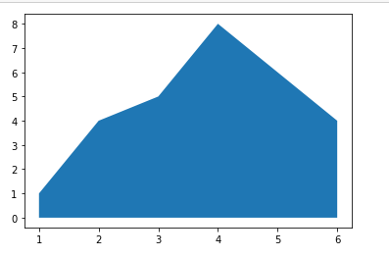
Example 1: to draw the area plot by using fill_between() function.
import matplotlib.pyplot as plt
# Create data
x=[1,2,3,4,6]
y=[1,4,5,8,4]
# Area plot
plt.fill_between(x, y)
plt.show()
01
08
Middle Level
Language
02
Memory
Management
Structured
Language
Speed
03
07
Rich Library
04
Pointers
Extensible
Recursion
05
MATPLOTLIB
UNIT-1
Department of CSE, School of Engineering, Malla Reddy University, Hyderabad.

Slide 8
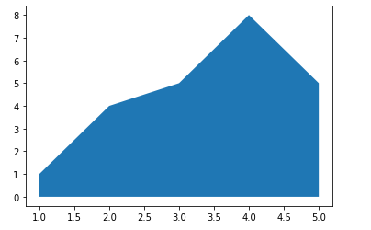
Example 1: to draw the area plot by using stackplot() function.
import matplotlib.pyplot as plt
# Create data
# x=range(1,6)
x=[1,2,3,4,5]
y=[1,4,5,8,5]
# Area plot
plt.stackplot(x,y)
plt.show()
Output:
01
08
Middle Level
Language
02
Memory
Management
Structured
Language
Speed
03
07
Rich Library
04
Pointers
Extensible
Recursion
05
MATPLOTLIB
UNIT-1
Department of CSE, School of Engineering, Malla Reddy University, Hyderabad.

Slide 9
Line Plot (or) Line chart:
Plt.plot(x,y)
plt. title()
plt. xlabel()
plt. ylabel()
Plt.show()
01
08
Middle Level
Language
02
Memory
Management
Structured
Language
Speed
03
07
Rich Library
04
Pointers
Extensible
Recursion
05
MATPLOTLIB
UNIT-1
Department of CSE, School of Engineering, Malla Reddy University, Hyderabad.

Slide 10
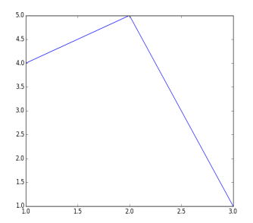
Example 1: to draw the line plot without labels by using plot() function.
import matplotlib.pyplot as plt
plt. plot ([1, 2, 3], [4, 5, 1])
plt.show ()
01
08
Middle Level
Language
02
Memory
Management
Structured
Language
Speed
03
07
Rich Library
04
Pointers
Extensible
Recursion
05
MATPLOTLIB
UNIT-1
Department of CSE, School of Engineering, Malla Reddy University, Hyderabad.

Slide 11
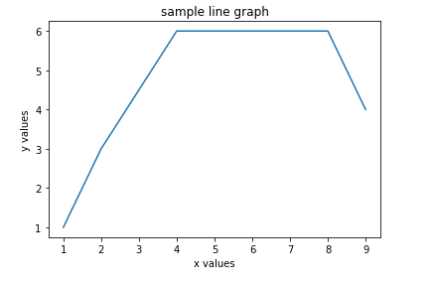
Example 2: to draw the line plot with labels by using plot() function.
x=[1,2,4,8,9]
y=[1,3,6,6,4]
plt.plot(x,y)
plt.title('sample line graph')
plt.xlabel('x values')
plt.ylabel('y values')
plt.show()
01
08
Middle Level
Language
02
Memory
Management
Structured
Language
Speed
03
07
Rich Library
04
Pointers
Extensible
Recursion
05
PYTHON PROGRAMMING
UNIT-1
Department of CSE, School of Engineering, Malla Reddy University, Hyderabad.

Slide 12
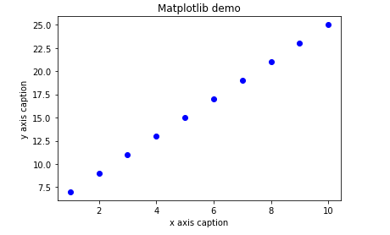
Formatting the style of the plot:
Example 3 :
import numpy as np
import matplotlib.pyplot as plt
x = np.arange (1, 11)
y = 2 * x + 5
plt.title ("Matplotlib demo")
plt.xlabel ("x axis caption")
plt.ylabel ("y axis caption")
# plt.plot(x, y, "bv")# blue and Triangle down marker.
plt.plot(x, y,"bo") # blue and circle marker
plt.show ()
01
08
Middle Level
Language
02
Memory
Management
Structured
Language
Speed
03
07
Rich Library
04
Pointers
Extensible
Recursion
05
MATPLOTLIB
UNIT-1
Department of CSE, School of Engineering, Malla Reddy University, Hyderabad.

Slide 13
Formatting the style of the plot:
Example 4 :
import matplotlib.pyplot as plt
plt. plot ([1, 2, 3], [4, 5, 1],label="plot one",linewidth=7)
plt. plot ([1, 5, 3], [4, 5, 6],label="plot two",linewidth=3)
plt.title('sample line graph')
plt.xlabel('x values')
plt.ylabel('y values')
plt.grid(True)
plt.legend()
plt.show ()
plt.show ()
01
08
Middle Level
Language
02
Memory
Management
Structured
Language
Speed
03
07
Rich Library
04
Pointers
Extensible
Recursion
05
MATPLOTLIB
UNIT-1
Department of CSE, School of Engineering, Malla Reddy University, Hyderabad.

Slide 14
3. Bar Plot (or) Bar chart:
A bar plot is a way of representing data where the length of the bars represents the magnitude/size of the feature/variable. Bar graphs usually represent numerical and categorical variables grouped in intervals.
The matplotlib API in Python provides the bar() function which can be used in MATLAB style use or as an object-oriented API. The syntax of the bar() function to be used with the axes is as follows:-
plt.bar(x, y, width, bottom, align)
The function creates a bar plot bounded with a rectangle depending on the given parameters.
01
08
Middle Level
Language
02
Memory
Management
Structured
Language
Speed
03
07
Rich Library
04
Pointers
Extensible
Recursion
05
MATPLOTLIB
UNIT-1
Department of CSE, School of Engineering, Malla Reddy University, Hyderabad.

Slide 15
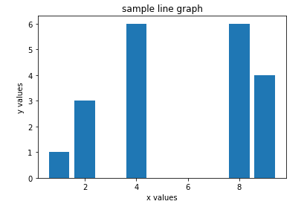
Example 1: to draw the bar plot:
import matplotlib.pyplot as plt
x=[1,2,4,8,9]
y=[1,3,6,6,4]
plt.bar(x,y)
plt.title('sample line graph')
plt.xlabel('x values')
plt.ylabel('y values')
plt.show()
01
08
Middle Level
Language
02
Memory
Management
Structured
Language
Speed
03
07
Rich Library
04
Pointers
Extensible
Recursion
05
MATPLOTLIB
UNIT-1
Department of CSE, School of Engineering, Malla Reddy University, Hyderabad.

Slide 16
Example 2: to draw the bar plot:
import matplotlib.pyplot as plt
plt.bar([1, 2, 3], [4, 5, 1],label="plot one")
plt.bar([1, 5, 3], [4, 5, 6],label="plot two") #color=g
plt.title('sample line graph')
plt.xlabel('x values')
plt.ylabel('y values')
plt.grid(True)
plt.legend()
plt.show ()
01
08
Middle Level
Language
02
Memory
Management
Structured
Language
Speed
03
07
Rich Library
04
Pointers
Extensible
Recursion
05
MATPLOTLIB
UNIT-1
Department of CSE, School of Engineering, Malla Reddy University, Hyderabad.

Slide 17
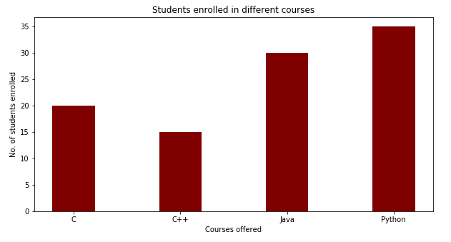
Example 2: to draw the bar plot:
import numpy as np
import matplotlib.pyplot as plt
# creating the dataset by using dictionary
data = {'C':20, 'C++':15, 'Java':30,'Python':35}
courses = list(data.keys())
values = list(data.values())
# creating the bar plot
plt.bar(courses, values, color ='maroon‘, width = 0.4)
plt.xlabel("Courses offered")
plt.ylabel("No. of students enrolled")
plt.title("Students enrolled in different courses")
plt.show()
Output:
01
08
Middle Level
Language
02
Memory
Management
Structured
Language
Speed
03
07
Rich Library
04
Pointers
Extensible
Recursion
05
MATPLOTLIB
UNIT-1
Department of CSE, School of Engineering, Malla Reddy University, Hyderabad.

Slide 18
4. Histogram:
Here First, we need to understand the differences between the bar graph and histogram. A histogram is used for the distribution, whereas a bar chart is used to compare different entities. A histogram is a type of bar plot that shows the frequency of a number of values compared to a set of values ranges.
For example we take the data of the different age group of the people and plot a histogram with respect to the bin. Now, bin represents the range of values that are divided into series of intervals known as “bins” . Bins are generally created of the same size.
In Matplotlib, we use the hist() function to create histograms. The hist() function will use an array of numbers to create a histogram.
01
08
Middle Level
Language
02
Memory
Management
Structured
Language
Speed
03
07
Rich Library
04
Pointers
Extensible
Recursion
05
MATPLOTLIB
UNIT-1
Department of CSE, School of Engineering, Malla Reddy University, Hyderabad.

Slide 19
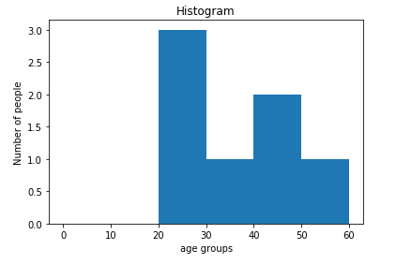
Example 1: to draw the Histogram:
from matplotlib import pyplot as plt
population_age = [21,53,49,25,27,30,45]
bins = [0,10,20,30,40,50,60]
plt.hist(population_age, bins)
plt.xlabel('age groups')
plt.ylabel('Number of people')
plt.title('Histogram')
plt.show()
Output:
01
08
Middle Level
Language
02
Memory
Management
Structured
Language
Speed
03
07
Rich Library
04
Pointers
Extensible
Recursion
05
MATPLOTLIB
UNIT-1
Department of CSE, School of Engineering, Malla Reddy University, Hyderabad.

Slide 20
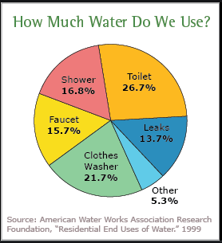
1. Pie Chart:
The “pie chart” is also known as “circle chart”, in which a circle is divided into sectors that each sector shows percentages of a whole.
In Matplotlib, we use the pie() function to create piechart
Pie chart image Example:
01
08
Middle Level
Language
02
Memory
Management
Structured
Language
Speed
03
07
Rich Library
04
Pointers
Extensible
Recursion
05
MATPLOTLIB
UNIT-1
Department of CSE, School of Engineering, Malla Reddy University, Hyderabad.

Slide 21
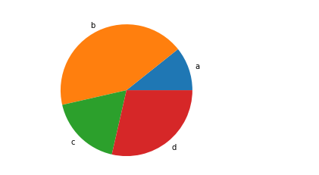
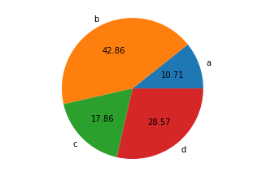
Example 1: to draw the Pie chart:
from matplotlib import pyplot as plt
values = [3, 12, 5, 8]
labels = ['a', 'b', 'c', 'd']
plt.pie(values, labels=labels) #autopct??
plt.show()
Output:
Example 2: to draw the Pie chart using autopct:
01
from matplotlib import pyplot as plt
values = [3, 12, 5, 8]
labels = ['a', 'b', 'c', 'd']
# autopct display % of whole.
plt.pie(values, labels=labels, autopct='%.2f‘)
plt.show()Output:
08
Middle Level
Language
02
Memory
Management
Structured
Language
Speed
03
07
Rich Library
04
Pointers
Extensible
Recursion
05
MATPLOTLIB
UNIT-1
Department of CSE, School of Engineering, Malla Reddy University, Hyderabad.

Slide 22
Example 3: to draw the Pie chart:
from matplotlib import pyplot as plt
values = [3, 12, 5, 8]
labels = ['a', 'b', 'c', 'd']
plt.pie(values, labels=labels) #autopct??
plt.show()
Output:
01
from matplotlib import pyplot as plt
values = [3, 12, 5, 8]
labels = ['a', 'b', 'c', 'd']
# autopct display % of whole.
plt.pie(values, labels=labels, autopct='%.2f‘)
plt.show()Output:
08
Middle Level
Language
02
Memory
Management
Structured
Language
Speed
03
07
Rich Library
04
Pointers
Extensible
Recursion
05
MATPLOTLIB
UNIT-1
Department of CSE, School of Engineering, Malla Reddy University, Hyderabad.

Slide 23
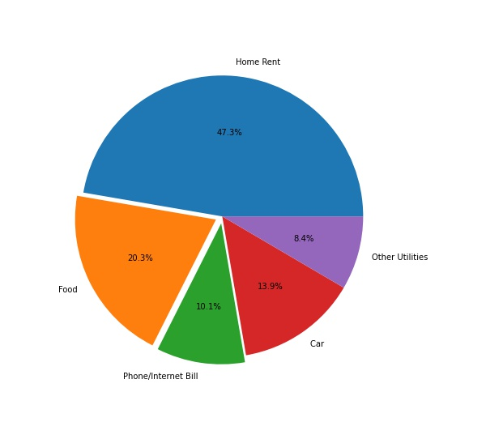
Example 3: to draw the Pie chart using explode:
from matplotlib import pyplot as plt
values = [3, 12, 5, 8]
mylabels = ['a', 'b', 'c', 'd']
plt.pie(values, labels=mylabels, autopct='%.2f, explode=[0,0.1,0.1,0,0])
plt.show()
01
08
Middle Level
Language
02
Memory
Management
Structured
Language
Speed
03
07
Rich Library
04
Pointers
Extensible
Recursion
05
MATPLOTLIB
UNIT-1
Department of CSE, School of Engineering, Malla Reddy University, Hyderabad.

Slide 24
2. Box plots:
A Box Plot is also known as Whisker plot is created to display the summary of the set of data values having properties like minimum, first quartile, median, third quartile and maximum.
In the box plot, a box is created from the first quartile to the third quartile, a line is also there which goes through the box at the median.
Here x-axis denotes the data to be plotted while the y-axis shows the frequency distribution.
In Matplotlib, we use the boxplot() function to create box plots.
01
08
Middle Level
Language
02
Memory
Management
Structured
Language
Speed
03
07
Rich Library
04
Pointers
Extensible
Recursion
05
MATPLOTLIB
UNIT-1
Department of CSE, School of Engineering, Malla Reddy University, Hyderabad.

Slide 25
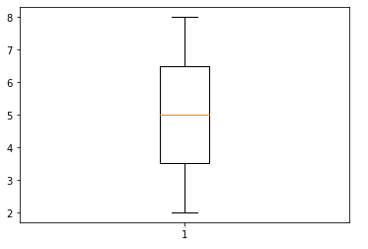
2. Box plots:
# Import libraries
import matplotlib.pyplot as plt
# create Dataset
y=[2,4,6,8]
# Creating plot
plt.boxplot(y)
# show plot
plt.show()
Output:
01
08
Middle Level
Language
02
Memory
Management
Structured
Language
Speed
03
07
Rich Library
04
Pointers
Extensible
Recursion
05
MATPLOTLIB
UNIT-1
Department of CSE, School of Engineering, Malla Reddy University, Hyderabad.

Slide 26
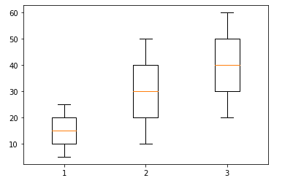
2. Multiple Box plots:
# Import libraries
import matplotlib.pyplot as plt
# create Dataset
x=[5,10,15,20,25]
y=[10,20,30,40,50]
z=[20,30,40,50,60]
data=[x,y,z]
# Creating plot
plt.boxplot(data)
# show plot
plt.show()
Output:
01
08
Middle Level
Language
02
Memory
Management
Structured
Language
Speed
03
07
Rich Library
04
Pointers
Extensible
Recursion
05
MATPLOTLIB
UNIT-1
Department of CSE, School of Engineering, Malla Reddy University, Hyderabad.

Slide 27
3. Scatter plots:
Scatter plots are used to observe relationship between x-axis and y-axis variables and uses dots to represent the relationship between them. The scatter() method in the matplotlib library is used to draw a scatter plot
In Matplotlib, we use the scatter() function to create scatter plots.
01
08
Middle Level
Language
02
Memory
Management
Structured
Language
Speed
03
07
Rich Library
04
Pointers
Extensible
Recursion
05
MATPLOTLIB
UNIT-1
Department of CSE, School of Engineering, Malla Reddy University, Hyderabad.

Slide 28
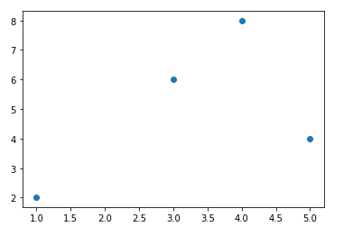
3. Scatter plots:
import matplotlib.pyplot as plt
# create Dataset
x=[1,5,3,4]
y=[2,4,6,8]
# Creating scatter plot
# plt.scatter(x,y,color=‘r’)
plt.scatter(x,y)
# show plot
plt.show()
01
08
Middle Level
Language
02
Memory
Management
Structured
Language
Speed
03
07
Rich Library
04
Pointers
Extensible
Recursion
05
MATPLOTLIB
UNIT-1
Department of CSE, School of Engineering, Malla Reddy University, Hyderabad.

Slide 29
Legend alignments:
Syntax:
upper right
upper left
lower left
lower right
right
center left
center right
lower center
upper center & center
legend={'loc': 'upper right'}
01
08
Middle Level
Language
02
Memory
Management
Structured
Language
Speed
03
07
Rich Library
04
Pointers
Extensible
Recursion
05
MATPLOTLIB
UNIT-1
Department of CSE, School of Engineering, Malla Reddy University, Hyderabad.

Slide 30
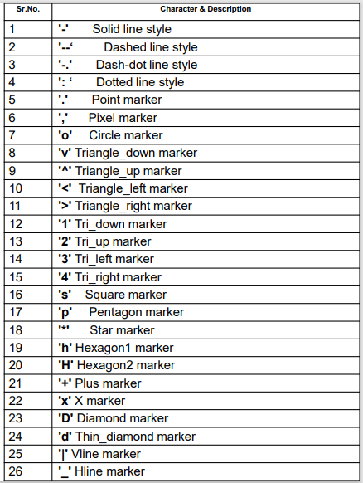
Line Plot Attribute:
line_type=“o”
01
08
Middle Level
Language
02
Memory
Management
Structured
Language
Speed
03
07
Rich Library
04
Pointers
Extensible
Recursion
05
MATPLOTLIB
UNIT-1
Department of CSE, School of Engineering, Malla Reddy University, Hyderabad.

Slide 31
Colour plotting:
Characters used for color
• 'b‘ blue
• 'g‘ Green
• 'r‘ Red
• 'c‘ Cyan
• 'm‘ Magenta
• 'y‘ Yellow
• 'k‘ Black
• 'w‘ White
color=“y”
01
08
Middle Level
Language
02
Memory
Management
Structured
Language
Speed
03
07
Rich Library
04
Pointers
Extensible
Recursion
05
MATPLOTLIB
UNIT-1
Department of CSE, School of Engineering, Malla Reddy University, Hyderabad.

Slide 32

www.mallareddyuniversity.com
Notes:
You can safely remove this slide. This slide design was provided by SlideModel.com – You can download more templates, shapes and elements for PowerPoint from http://slidemodel.com

